Slide 1
COMPETITOR ANALYSIS REPORT
VS
VS
BY VIDHI SHARMA

Slide 2
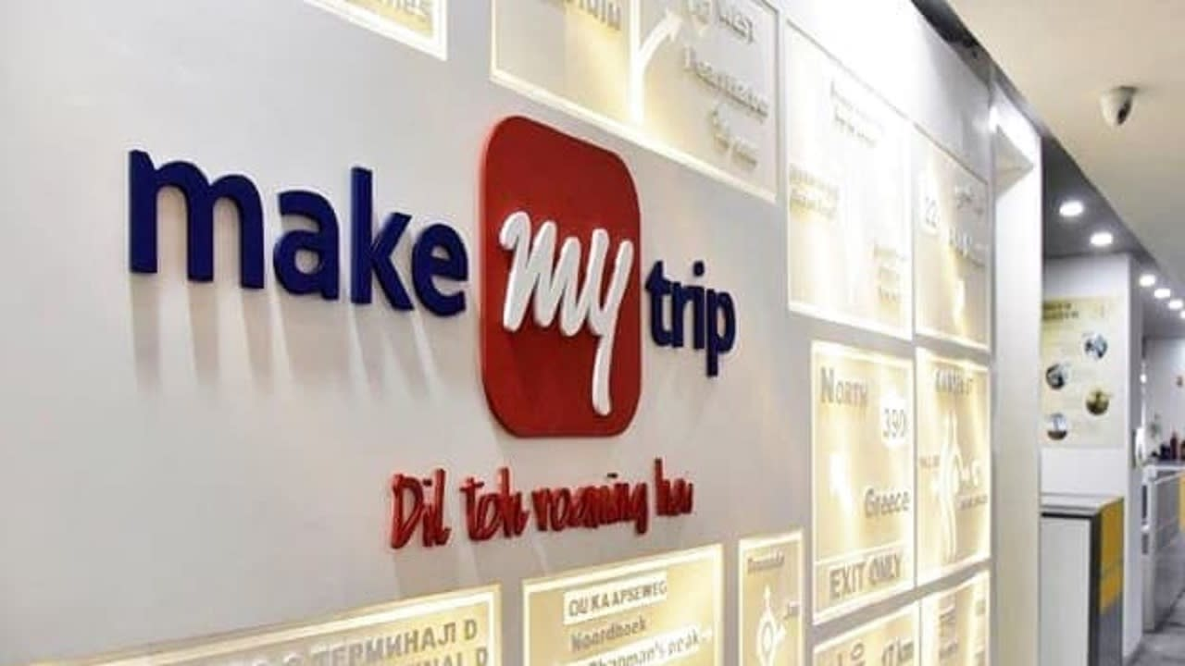
MAKE MY TRIP
Established in 2000, MakeMyTrip is a prominent online travel firm in India.
In 2005, they grew into domestic operations, initially concentrating on flights before introducing hotels and vacation packages.
MakeMyTrip has implemented AI/ML tools to personalize trip recommendations and enhance search functionality. Their smartphone app is a primary focus, including tools for handling reservations, in-trip help, and loyalty programs.
They provide an array of travel services such as scheduling flights, hotel reservations, vacation packages, train tickets etc.
This Photo by Unknown Author is licensed under CC BY-SA-NC

Slide 3
TOP 3 COMPETITORS OF MAKEMYTRIP ARE :-
GOIBIBO
YATRA
CLEARTRIP
Another prominent online travel portal, Yatra, offers a diverse selection of travel items such as flights, hotels, vacation packages, trains, and bus tickets. They prioritize a user-friendly interface and customer service.
Owned by the Mahindra Group, Goibibo provides services comparable to MakeMyTrip, such as flights, hotels, holiday packages, and bus tickets. They are well-known for offering competitive prices and running frequent discounts.
SERVICES
This established online travel firm, similar to MakeMyTrip, provides a wide range of services such as flights, hotels, vacation packages, and vehicle rentals. Cleartrip is noted for its emphasis on international travel and frequently caters to corporate travelers.
VS
VS

Slide 4
BRAND AND THEIR SOCIAL MEDIA FOLLOWERS
BRAND | INSTAGRAM | FACEBOOK | TWITTER
MAKEMYTRIP | 228K | 2.5M | 131K
GOIBIBO | 89.5K | 2M | 82.5K
YATRA | 99.5K | 2.3M | 66.9K
CLEARTRIP | 71.2K | 995K | 32.9K
Mercury is the closest planet to the Sun
MERCURY
JUPITER
Yes, Saturn is the ringed one. It’s a gas giant
SATURN

Slide 5
MARKETING STRATEGY
MAKEMYTRIP
GOIBIBO
YATRA
CLEARTRIP
Extensive TV and digital advertising campaigns featuring celebrities.
Aggressive online advertising with a focus on budget travel.
Offering curated travel packages and experiences.
Marketing campaigns targeted towards international travel destinations.
Focus is on user-friendly website and app.
Frequent flash sales and promotional offers.
Investing in strong customer service to build trust.
Focus on features catering to business travellers
Strong loyalty program "My Trip Rewards" to retain customers.
Partnerships with budget airlines and hotels.
Targeting specific customer segments like families and business travellers.
Investing in AI-powered travel recommendations
Content marketing through travel blogs and destination guides.
Building a strong mobile app presence.
Focus on clean and user-friendly website and app design.
Highlighting their curated travel experiences for a premium audience.
Frequent deals and discounts to attract customers.

Slide 6
MARKETING CAMPAIGN
MAKEMYTRIP
GOIBIBO
#Wanderlust Wednesdays: This social media campaign used the hashtag #WanderlustWednesdays to share travel inspiration and deals every Wednesday. It generated user engagement and brand awareness.
Goibibo's "Sale Sharks" campaign: This campaign featured a quirky shark mascot to promote their app and various travel deals. The lighthearted and humorous approach resonated with budget-conscious travellers.
IPL Sponsorships: MakeMyTrip has leveraged sponsorships with the Indian Premier League (IPL) to reach a massive audience and gain brand recognition through high-profile cricket matches.
"Selfie on the Go" contest: This social media contest encouraged users to share travel selfies on the Goibibo app for a chance to win prizes. This boosted user engagement and app downloads.
YATRA
CLEARTRIP
#FindYourCalling campaign: Yatra partnered with a celebrity for a social media campaign focused on self-discovery through travel. This campaign targeted millennials and aimed to connect travel with personal growth.
"Book Now, Travel Later" campaign: Cleartrip offered flexible booking options and deals to encourage travel planning during the pandemic.
AI-powered travel recommendations: Cleartrip has implemented AI technology to personalize travel recommendations for users based on their preferences. This caters to the growing demand for a more curated travel experience.
Yatra Cares: This customer-centric campaign highlighted Yatra's focus on exceptional customer service. This built trust and loyalty among travellers.

Slide 7
CONCLUSION
In India's competitive online travel booking scene, each company - MakeMyTrip, Goibibo, Yatra, and Cleartrip - strives to establish its own identity through unique digital marketing methods.
No single company dominates with every digital marketing tactic.
MakeMyTrip is good at building brand awareness, but Goibibo does better at running campaigns on a tight budget.
Cleartrip customizes the experience to specific passenger groups, while Yatra places a high priority on the customer experience.
In the end, the target market and the organization's objectives determine the "best" digital marketing strategy.

Slide 8
THANK YOU

